Slide 1

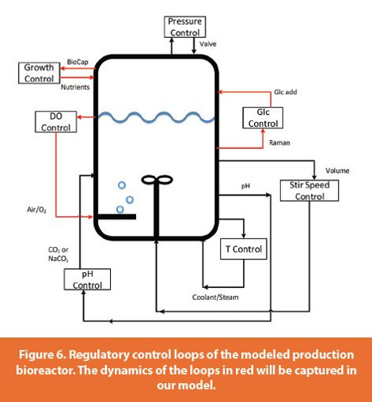
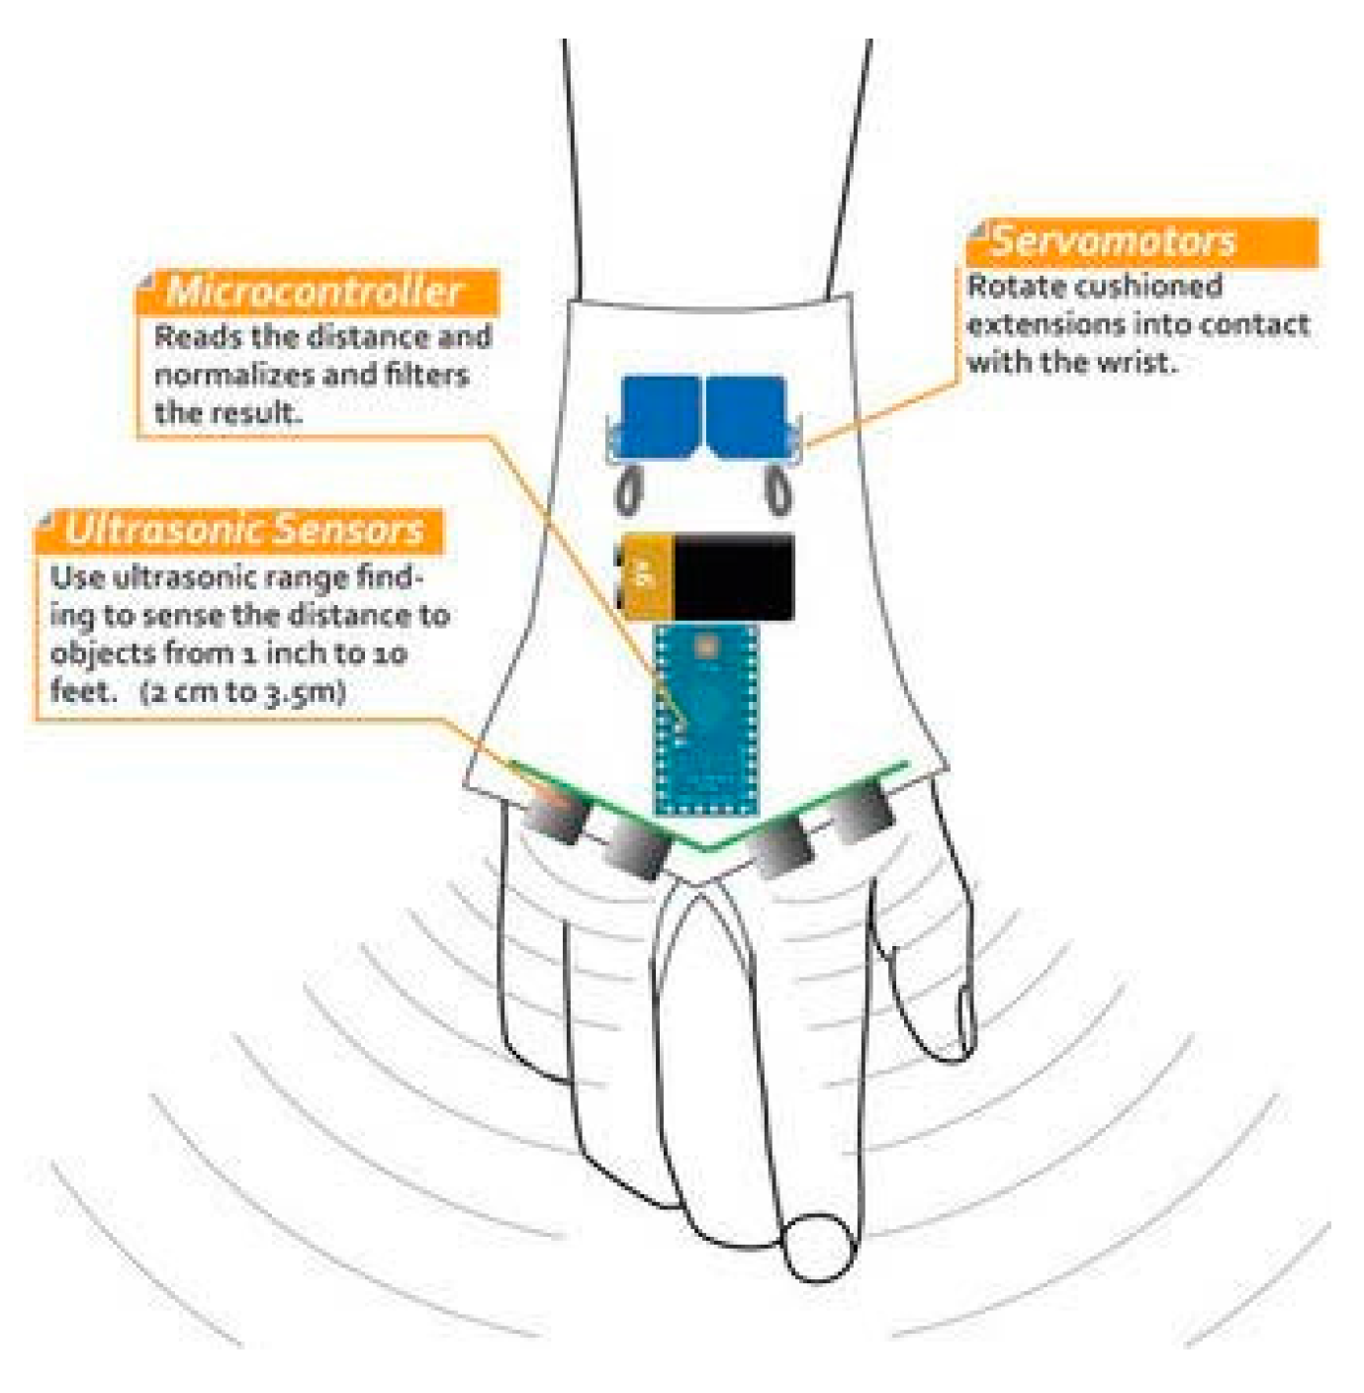
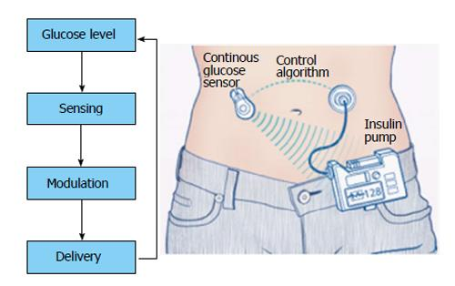
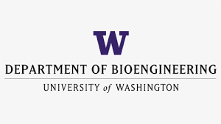

BIOEN 438/538: Biomedical Control Systems Engineering
Winter, 2026. MW 1:00 – 2:20.
Joseph L. Hellerstein, jlheller@uw.edu (eScience Institute, Bioengineering)
Herbert S Sauro, hsauro@uw.edu (Bioengineering, eScience Institute)
Bioreactor Control
Medical Device Control
Insulin Control
Engineers have long used feedback to control unreliable devices and regulate complex processes. Applications in biology include bioreactors, medical devices, and the analysis of biochemical networks This course teaches the basics of control engineering to bioengineers and allied disciplines. Some learning objectives are:
build PID controllers for in silico biological systems;
design PID controllers using root locus analysis;
analyze arbitrary biochemical networks using linear control theory;
build a biochemical integral controller and analysis its dynamics using linear control theory.
Prerequisites: BIOEN 336 (Bioengineering systems & control) or equivalent.

